Slide 1
IL RUOLO DEL CHIRURGO D'URGENZA
G. Salamone
U.O. C. CHIRURGIA GENERALE E D’URGENZA

Slide 2
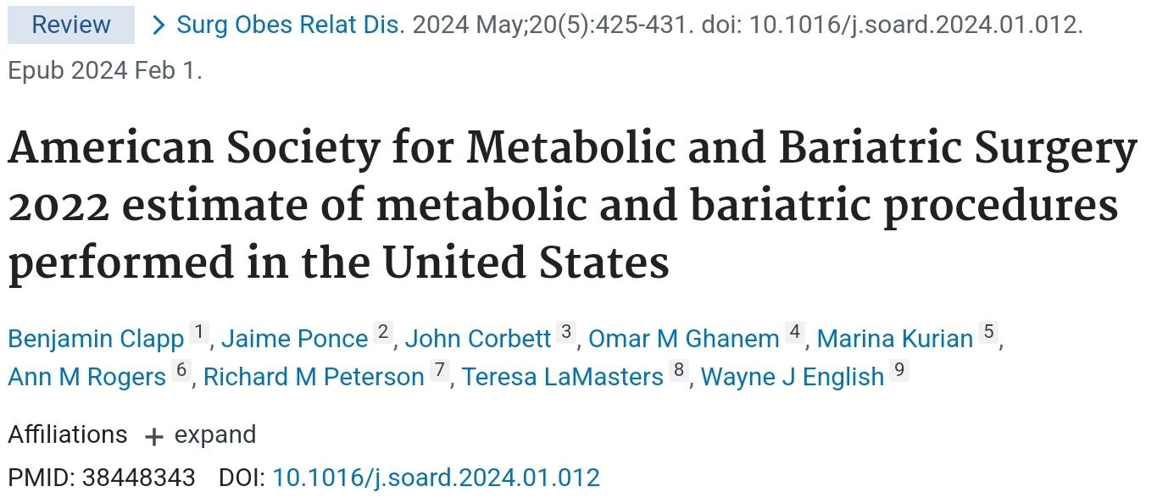

Slide 3
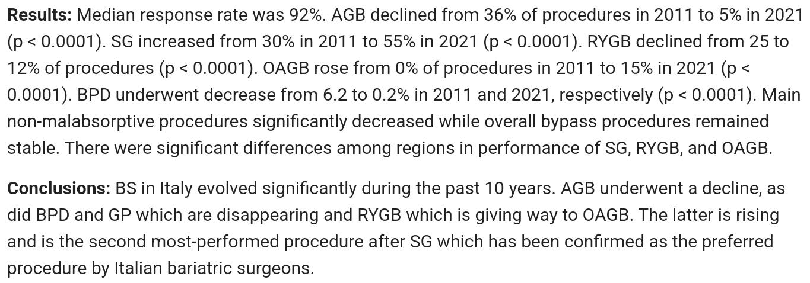
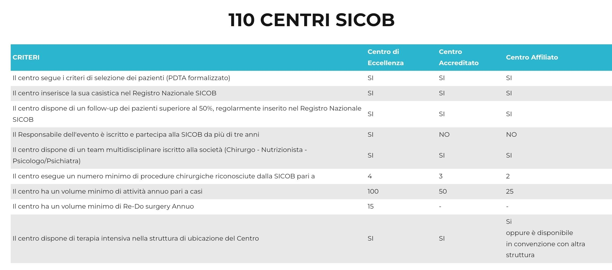
Assenza di centri di riferimento

Slide 4
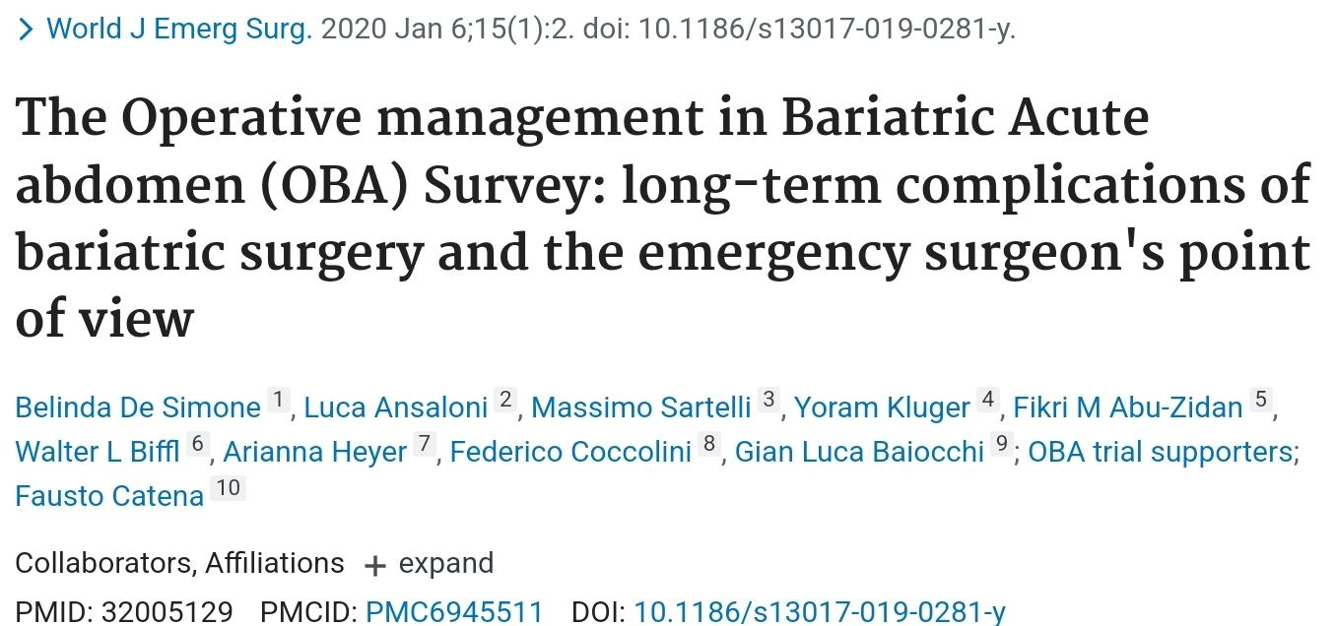
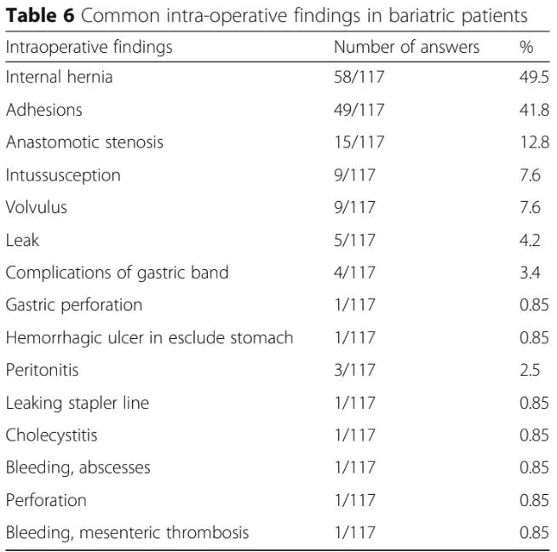
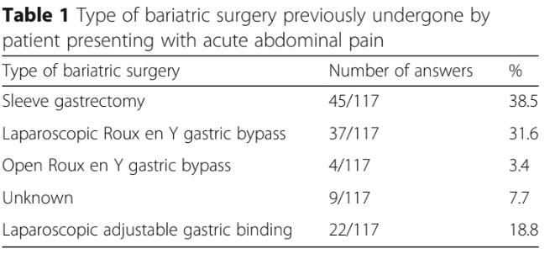

Slide 5
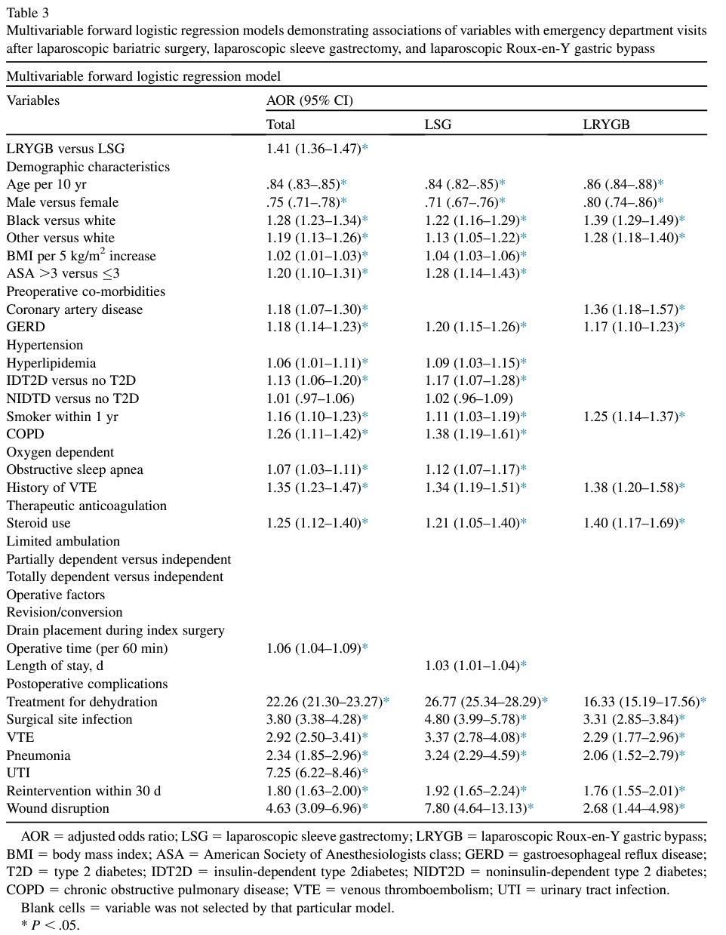
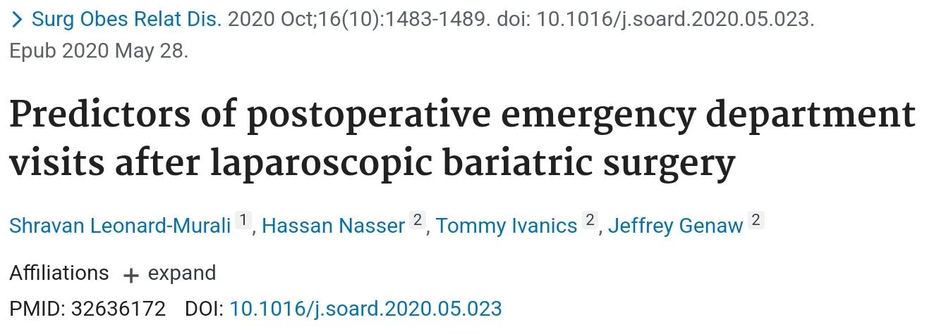
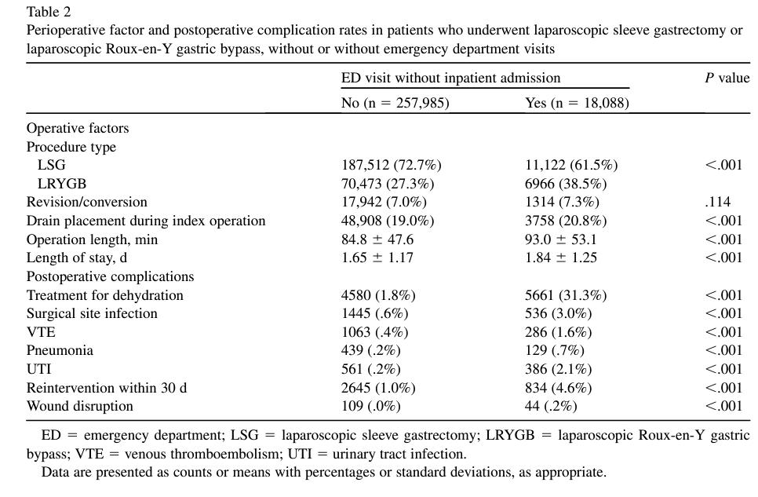

Slide 6
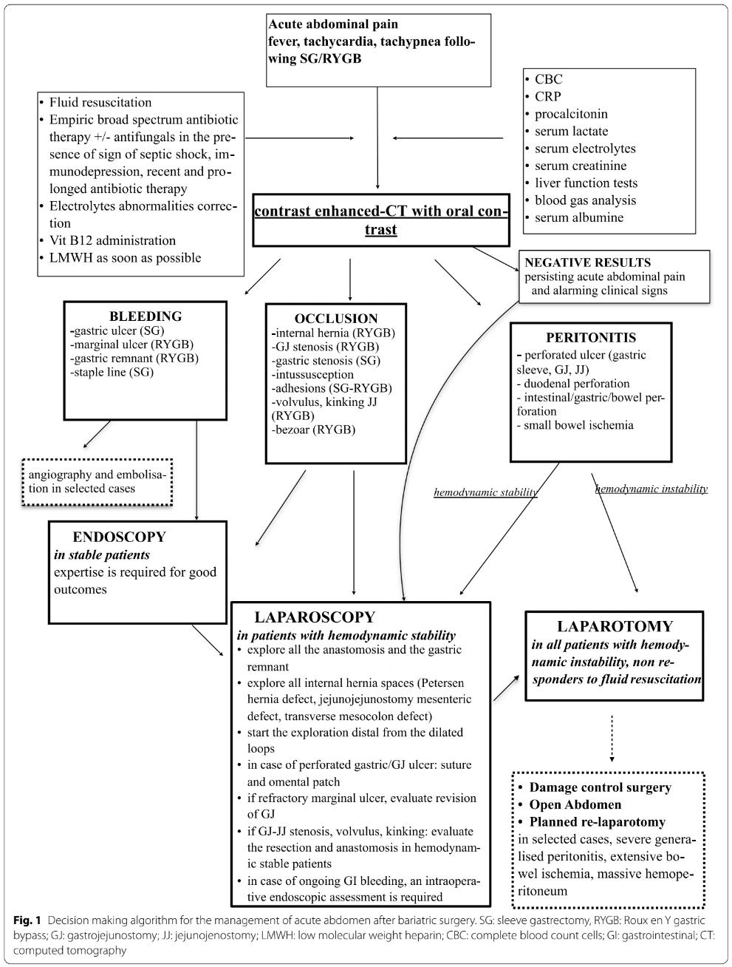
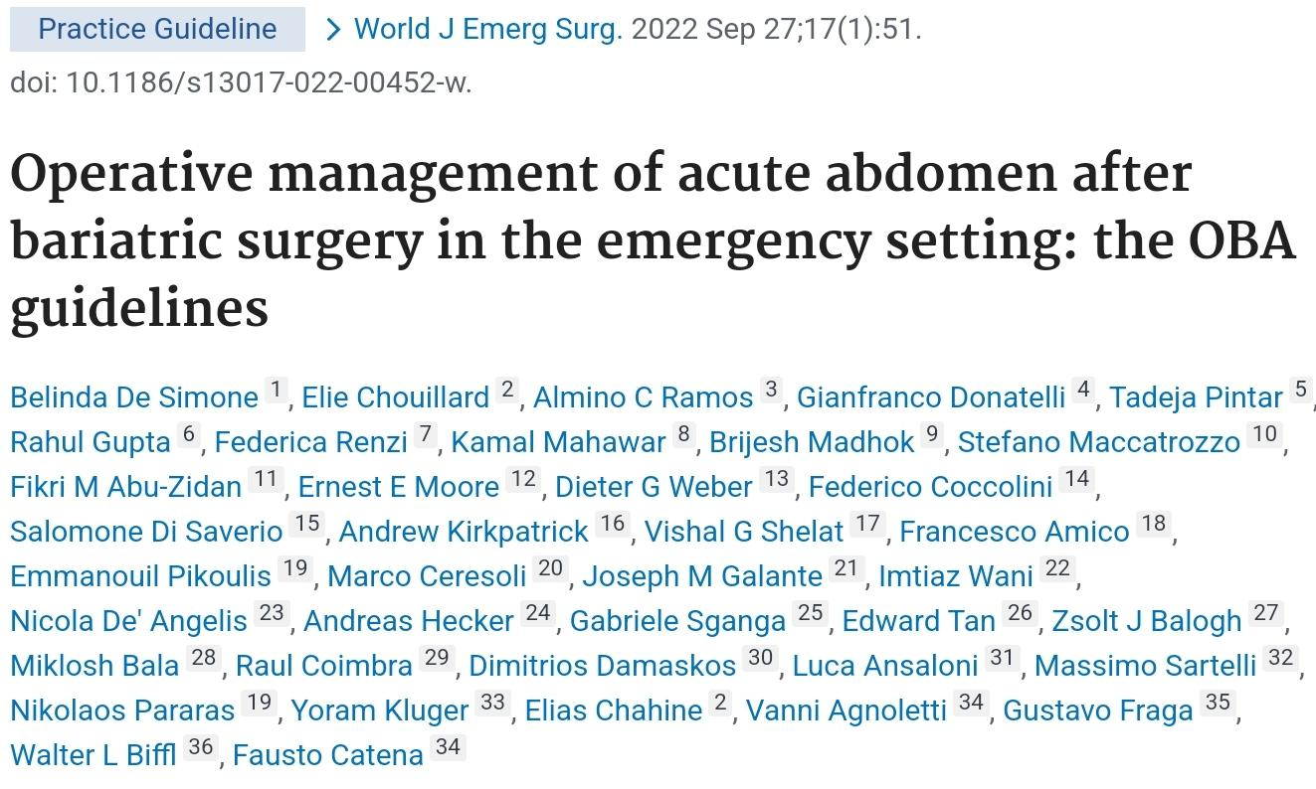

Slide 7
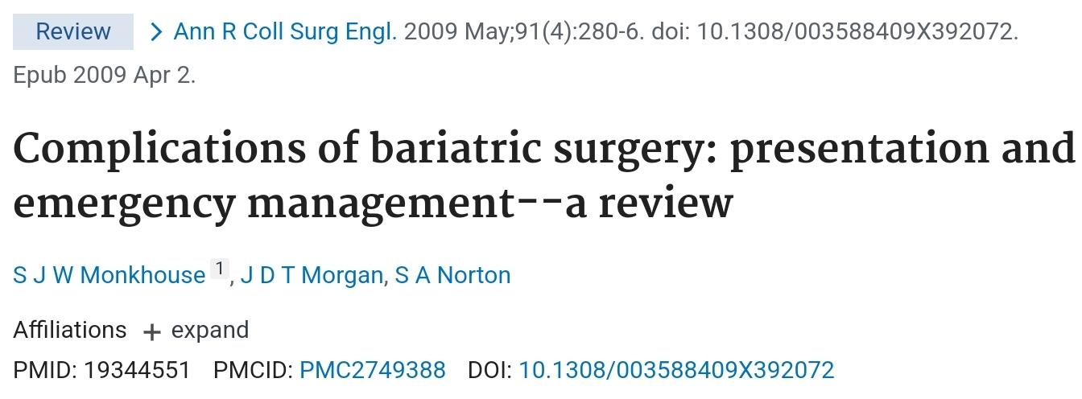
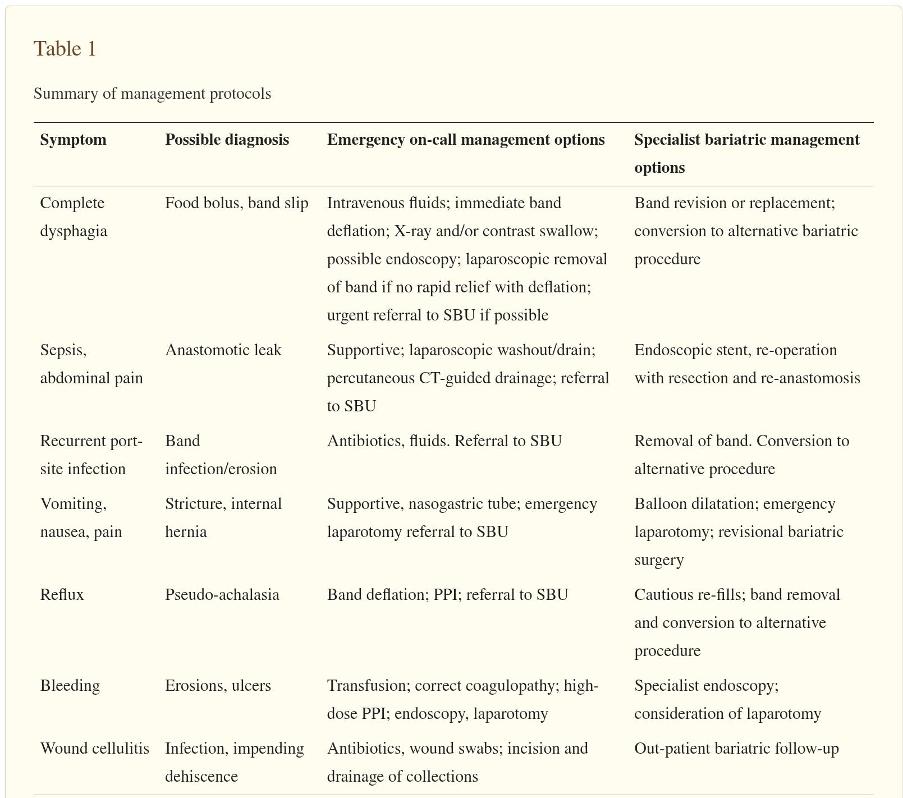
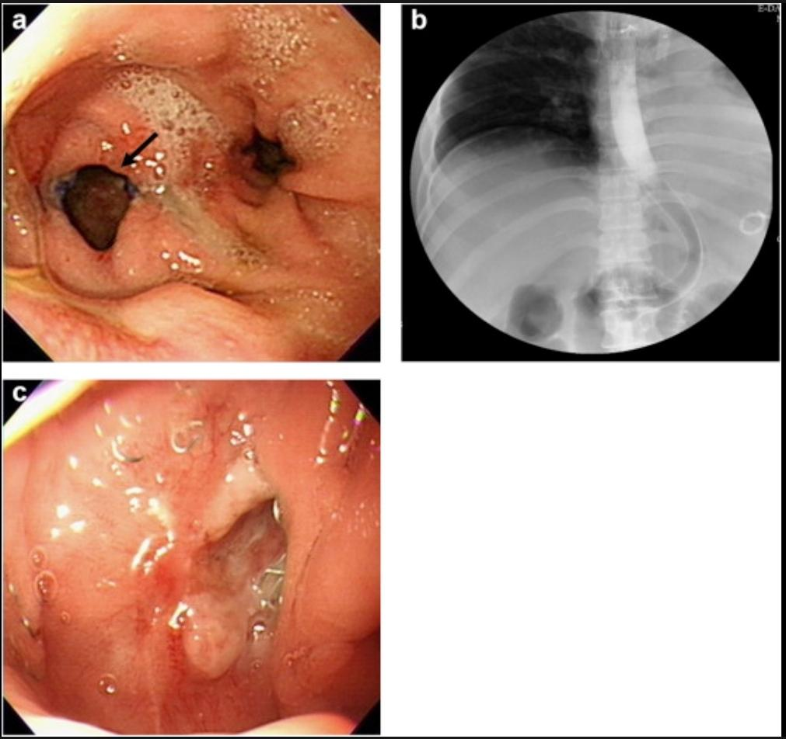
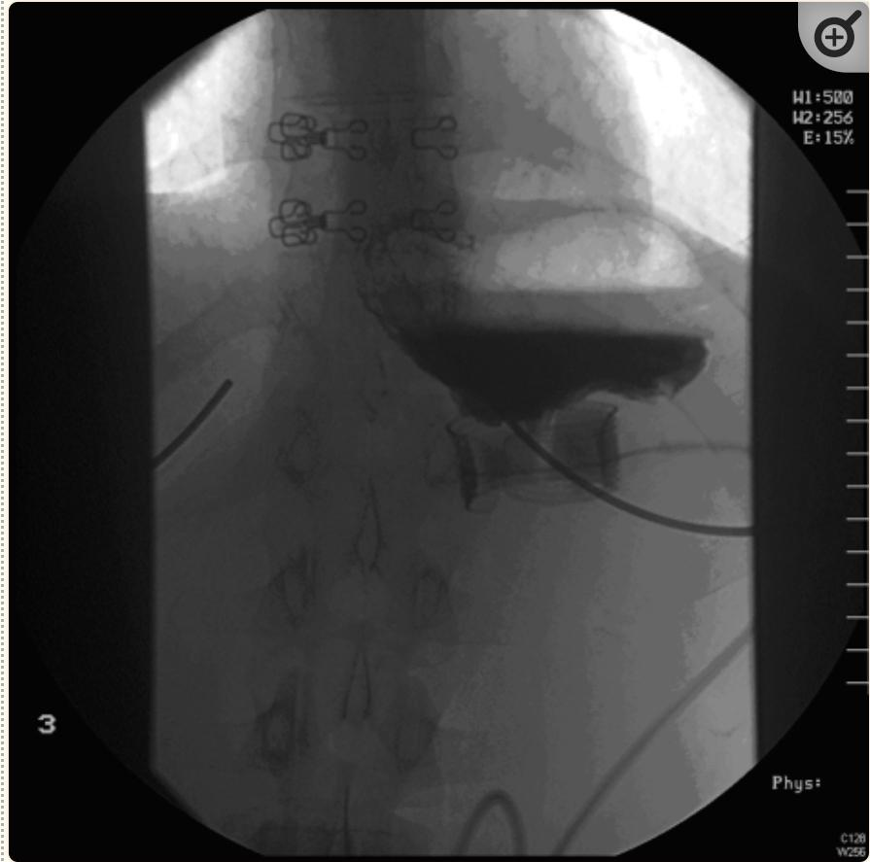

Slide 8
Thanks
CONCLUSIONS
Obesity is the pathology within pathologies and needs a multidisciplinary approach to bring the patient to the surgical procedure only at the end of a proper diagnostic course.
The patient undergoing bariatric surgery have both short-term and long-term complications.
The lack of ubiquity of accredited bariatric centers with emergency department availability often delivers these patients to the emergency surgeon.
The clinical approach to Bariatric Acute Abdomen is not easy.
Only a multidisciplinary approach, including the bariatric surgeon, allows proper management of the obese patient with long-term complication.

